Slide 1
CodePath
Week 1
CS 4760 F18
Christopher Raley

Slide 2
Fundamental Security Principles
HTTP Requests
URL Manipulation
Insecure Direct Object Reference (IDOR)
Topics
Week 1
Readings available on CodePath Course website

Slide 3
Fundamental Security Principles
Never trust users
Least privilege
Simple is more secure
Expect the unexpected
5. Defense in depth
6. Security through obscurity
7. Prefer whitelisting over blacklisting
8. Map data movement and exposure
Notes:
Remember these CONCEPTS. They can be tweaked in different ways.

Slide 4
HTTP Requests
HTTP (HyperText Transfer Protocol) - Used to send requests to web servers
Request Types: GET, POST, HEAD, PUT, DELETE, CONNECT, OPTIONS

Slide 5
HTTP GET/POST Requests
GET
POST
Used when data data does not change
View, search, sort, or filter data
Sent when URL is entered in the browser and links are clicked on
Used when data does change
Create, update, or delete data
Sent when web forms are submitted

Slide 6
Attack: URL Manipulation
URL’s act not only as identifiers for other websites, but as requesters as well
Recall GET/POST Requests
Nothing stops an attacker from entering other possible “commands” in the address bar
Websites that do not take account into this fact can be vulnerable

Slide 7
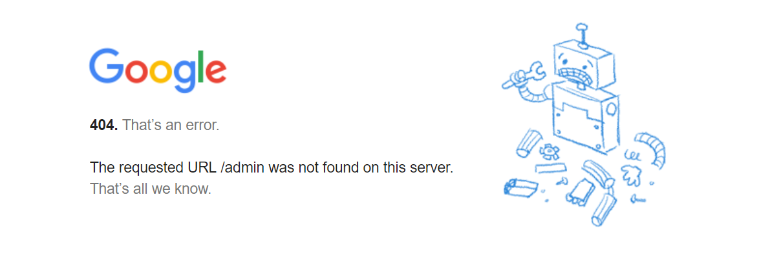
URL Manipulation Prevention
Just because the user can’t see a link to a specific URL, doesn’t mean that it is not there
Don’t consider URLs to be private
Error handling
Expect the unexpected

Slide 8
Attack: IDOR
Insecure Direct Object Reference
When a direct reference to an object is available without proper authentication
Usually concerned with databases, files, directories, etc.

Slide 9
What’s the vulnerability?
http://foo.com/receipt?invoice=TPX-10457

Slide 10
IDOR Prevention
Validate the user’s credentials (most effective)
Reject all input, except for acceptable ones
Direct Object References -> Indirect Object References
Make it meaningful to only the actual user

Slide 11
Lab 1
Introduction to Burp and Security Shepherd

Slide 12
Installing Burp Proxy

Slide 13
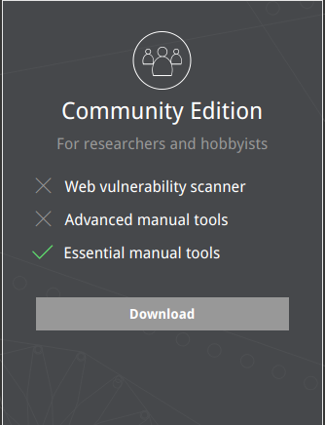
https://portswigger.net/burp
Download and install the Community Edition

Slide 14
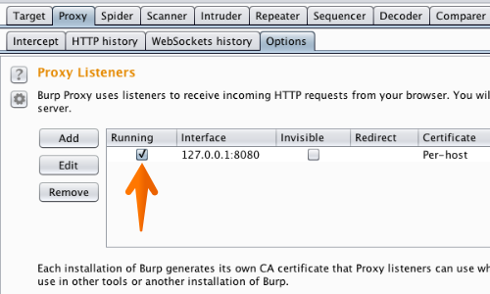
Run Burp and click “Next”, then “Start Burp”
Go to the “Proxy” tab then “Options”
Make sure that the “Interface” matches the image on the right

Slide 15
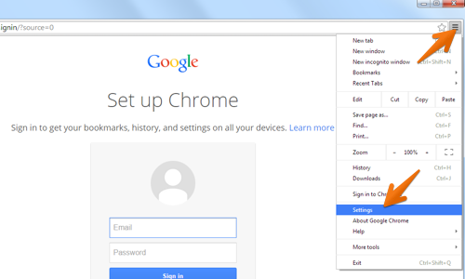
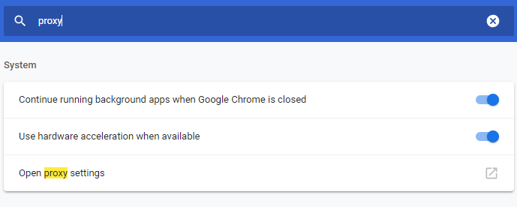
Go to Chrome Menu (Top-right)
Go to Settings
Search for “proxy”
Select “Open proxy settings”
Go to the Connections tab, and click on the "LAN settings" button
Make sure only “Use a proxy server…” is checked
Enter “127.0.0.1” in “Address” field and “8080” in “Port” field
Then click on the "Advanced" button.
Make sure the "Use the same proxy server for all protocols" box is checked.
Delete anything that appears in the "Exceptions" field.
Then click "OK" to close all of the options dialogs.

Slide 16
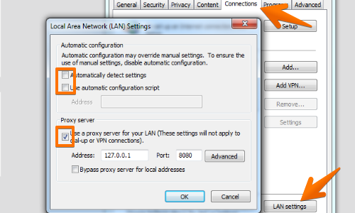
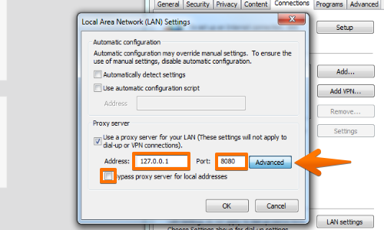
Go to Chrome Menu (Top-right)
Go to Settings
Search for “proxy”
Select “Open proxy settings”
Go to the Connections tab, and click on the "LAN settings" button
Make sure only “Use a proxy server…” is checked
Enter “127.0.0.1” in “Address” field and “8080” in “Port” field
Then click on the "Advanced" button.
Make sure the "Use the same proxy server for all protocols" box is checked.
Delete anything that appears in the "Exceptions" field.
Then click "OK" to close all of the options dialogs.

Slide 17
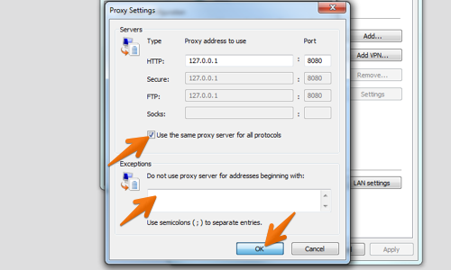
Go to Chrome Menu (Top-right)
Go to Settings
Search for “proxy”
Select “Open proxy settings”
Go to the Connections tab, and click on the "LAN settings" button
Make sure only “Use a proxy server…” is checked
Enter “127.0.0.1” in “Address” field and “8080” in “Port” field
Then click on the "Advanced" button.
Make sure the "Use the same proxy server for all protocols" box is checked.
Delete anything that appears in the "Exceptions" field.
Then click "OK" to close all of the options dialogs.

Slide 18
Proxy is done… but we can’t access websites that use HTTPS…
More on why later in the course!

Slide 19
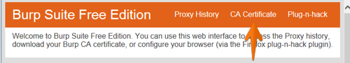
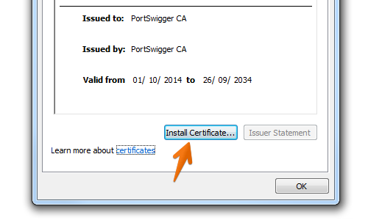
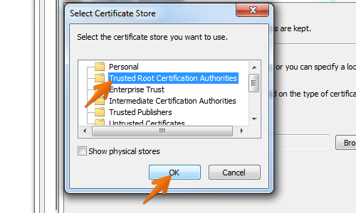
Launch Google Chrome
With Burp running, visit http://burp in the address bar and click the “CA Certificate” bar at the top right to download and save your Burp CA certificate
Open the downloaded certificate
Click “Install Certificate”.
In the “Certificate Import Wizard” dialog box click “Next”.
In the Certificate Import Wizard, select "Place all certificates in the following store" and click “Browse”.
In the “Select Certificate Store” window select "Trusted Root Certification Authorities" and click “OK”.
Complete the wizard by clicking “Next” followed by “Finish”.
Click "Yes" on the security warning.
Restart Chrome

Slide 20
Go to Proxy -> HTTP history and try browsing the web
Make sure that you can access websites that use HTTPS
You should be able to see GET/POST requests

Slide 21
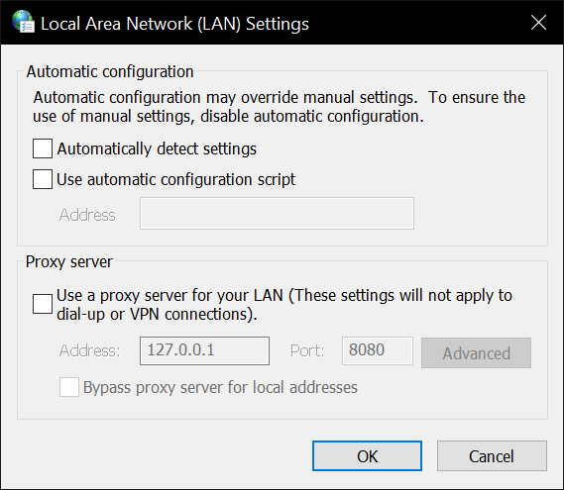
You can only browse when the Burp Proxy is active.
Uncheck “Use a proxy server for your LAN…” to use Chrome normally.

Slide 22
https://security.codepath.com/login.jsp
* Go to Proxy -> Intercept and click on the “Intercept is on” so that it says “Intercept is off”

Slide 23
Introduction to CTF’s
“A cyber security CTF is a competition between security professionals and/or students learning about cyber security”
We will be focusing on a Jeopardy style CTF

Slide 24
https://ctf.codepath.com
* If you haven’t registered yet, do so now at the link

Slide 25
Office Hours
Monday / Thursday : 5 - 7 PM @ Rice 226

